Slide 1
Interrupts and Low Power Features

Slide 2
Module Syllabus
Interrupts
What are interrupts?
Why use interrupts?
Interrupts
Entering an Exception Handler
Exiting an Exception Handler
Port Module and External Interrupts
Timing Analysis
Program Design with Interrupts

Slide 3
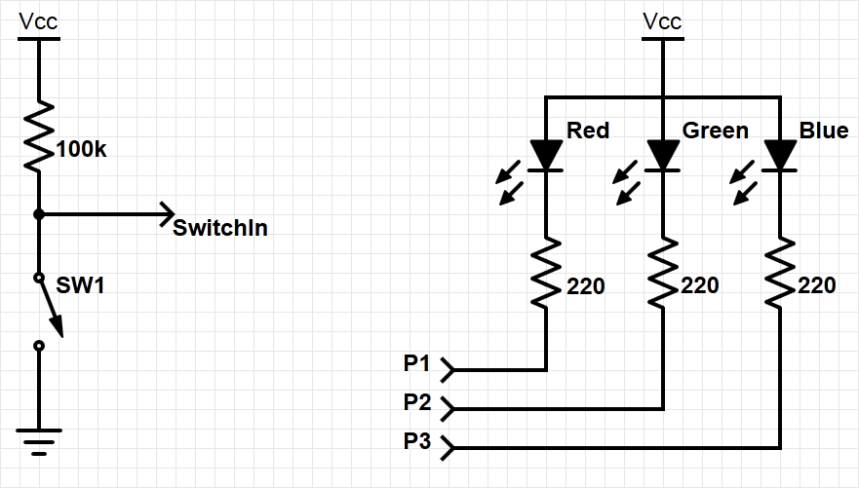
Example System with Interrupt
Goal: change the colour of the RGB LED when switch is pressed
Need to add an external switch
(resistor is internal – a pull-up resistor)

Slide 4
How to Detect when a Switch is Pressed?
Polling – use software to regularly check it
Slow – need to explicitly check to see if switch is pressed
Wasteful of CPU time – the faster a response we need, the more often we need to check
Scales badly – difficult to build a system with many activities which can respond quickly. Response time depends on all other processing.
Interrupt – use special hardware in MCU to detect event and run ISR in response
Efficient – code runs only when necessary
Fast – hardware mechanism
Scales well
ISR response time doesn’t depend on most other processing
Code modules can be developed independently

Slide 5
Interrupt or Exception Processing Sequence
Main code is running
Interrupt trigger occurs
Processor does some hard-wired processing
Processor executes the ISR, including return-from-interrupt instruction at the end
Processor resumes to main code
Hardwired CPU response activities
Interrupt Routine
Main Code
Time

Slide 6
Interrupts
Hardware-triggered asynchronous software routine
Triggered by hardware signal from peripheral or external device
Asynchronous – can happen anywhere in the program (unless interrupt is disabled)
Software routine – Interrupt Service Routine runs in response to interrupt
Fundamental mechanism of microcontrollers
Provides efficient event-based processing rather than polling
Provides quick response to events regardless of program state, complexity, location
Allows many multithreaded embedded systems to be responsive without an operating system (specifically task scheduler)

Slide 7
Example Program Requirements & Design
MAIN
RGB LED
SW
ISR
count
(does initialization, then updates LED based on count)
Global Variable
ISR
MAIN
When switch SW is pressed, ISR will increment count variable
Main code will light LEDs according to count value in binary sequence (Blue: 4, Green: 2, Red: 1)
Main code will toggle its debug line each time it executes
ISR will raise its debug line (and lower main’s debug line) whenever it is executing

Slide 8
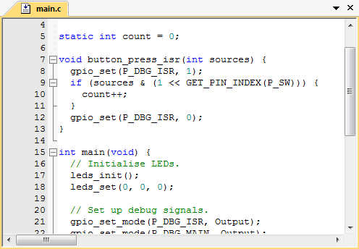
Example Exception Handler
We will examine processor’s response to exception in detail

Slide 9
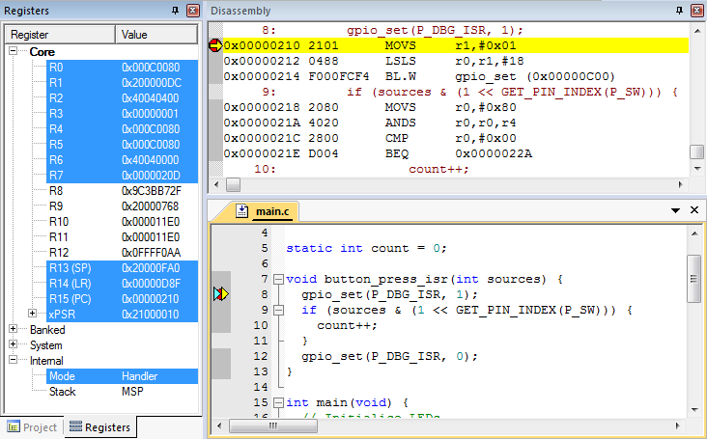
Use Debugger for Detailed Processor View
Can see registers, stack, source code, disassembly (object code)
Note: Compiler may generate code for function entry
Place breakpoint on Handler function declaration line in source code, not at first line of code

Slide 10
Entering an Exception Handler

Slide 11
CPU’s Hardwired Exception Processing
Finish current instruction
Except for lengthy instructions
Push context (registers) onto current stack (MSP or PSP)
xPSR, Return Address, LR(R14), R12, R3, R2, R1, R0
Switch to handler/privileged mode, use MSP
Load PC with address of interrupt handler
Load LR with EXC_RETURN code
Load IPSR with exception number
Start executing code of interrupt handler
Usually 16 cycles from exception request to execution of first instruction in handler

Slide 12
1. Finish Current Instruction
Most instructions are short and finish quickly
Some instructions may take many cycles to execute
Load Multiple (LDM), Store Multiple (STM), Push, Pop, MULS (32 cycles for some CPU core implementations)
This will delay interrupt response significantly
If one of these is executing when the interrupt is requested, the processor:
abandons the instruction
responds to the interrupt
executes the ISR
returns from interrupt
restarts the abandoned instruction

Slide 13
2. Push Context onto Current Stack
 |  | <previous> | SP points here before interrupt
 | SP + 0x1C | xPSR
 | SP + 0x18 | PC
Decreasing | SP + 0x14 | LR
memory | SP + 0x10 | R12
address | SP + 0x0C | R3
 | SP + 0x08 | R2
 | SP + 0x04 | R1
 | SP + 0x00 | R0 | SP points here upon entering ISR
Two SPs: Main (MSP), process (PSP)
Which is active depends on operating mode, CONTROL register bit 1
Stack grows toward smaller addresses

Slide 14
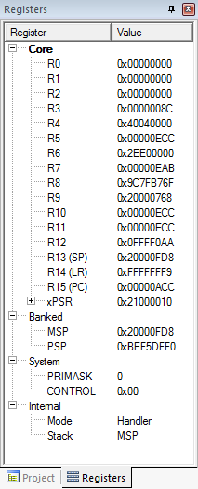
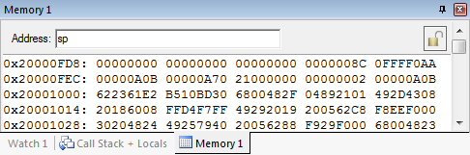
Context Saved on Stack
SP value is reduced since registers have been pushed onto stack
Saved R0
Saved R1
Saved R2
Saved R3
Saved R12
Saved LR
Saved PC
Saved xPSR

Slide 15
3. Switch to Handler/Privileged Mode
Handler mode always uses Main SP
Reset
Thread
Mode. MSP or PSP.
Exception Processing
Completed
Starting Exception Processing
Handler Mode
MSP

Slide 16
Handler and Privileged Mode
Mode changed to Handler. Was already using MSP

Slide 17
Update IPSR with Exception Number
Exception number 0x10 (interrupt number + 0x10)

Slide 18
4. Load PC With Address Of Exception Handler
Memory Address | Value
0x0000_0000 | Initial Stack Pointer
0x0000_0004 | Reset
0x0000_0008 | NMI_IRQHandler
…
 | IRQ0_Handler
 | IRQ1_Handler
…
Reset:
…
NMI_IRQHandler:
…
IRQ0_Handler:
…
IRQ1_Handler:
The program counter is selected from the vector table depending on exception

Slide 19
Can Examine Vector Table With Debugger
Exception number | IRQ number | Vector | Offset
 |  | Initial SP | 0x00
1 |  | Reset | 0x04
2 | -14 | NMI | 0x08
3 | -13 | HardFault | 0x0C
4 |  | Reserved | 0x10
5
6
7
8
9
10
11 | -5 | SVCall | 0x2C
12 |  | Reserved
13
14 | -2 | PendSV | 0x38
15 | -1 | SysTick | 0x3C
16 | 0 | IRQ0 | 0x40
17 | 1 | IRQ1 | 0x44
18 | 2 | IRQ2 | 0x48
. |  | .
16+n | n | IRQn | 0x40+4n
Why is the vector odd?
LSB of address indicates that handler uses Thumb code

Slide 20
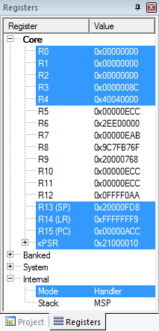

Upon Entry to Handler
PC has been loaded with start address of handler

Slide 21
5. Load LR With EXC_RETURN Code
EXC_RETURN | Return Mode | Return Stack | Description
0xFFFF_FFF1 | 0 (Handler) | 0 (MSP) | Return to exception handler
0xFFFF_FFF9 | 1 (Thread) | 0 (MSP) | Return to thread with MSP
0xFFFF_FFFD | 1 (Thread) | 1 (PSP) | Return to thread with PSP
EXC_RETURN value generated by CPU to provide information on how to return
Which SP to restore registers from? MSP (0) or PSP (1)
Previous value of SPSEL
Which mode to return to? Handler (0) or Thread (1)
Another exception handler may have been running when this exception was requested

Slide 22
Updated LR With EXC_RETURN Code

Slide 23
6. Start Executing Exception Handler
Exception handler starts running, unless preempted by a higher-priority exception
Exception handler may save additional registers on stack
E.g. if handler may call a subroutine, LR and R4 must be saved

Slide 24
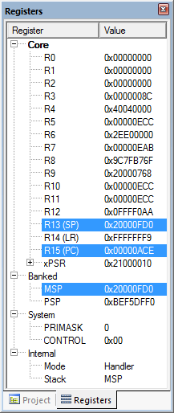
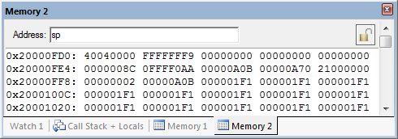
After Handler Has Saved More Context
Saved R4
Saved LR
Saved R0
Saved R1
Saved R2
SP value reduced since registers have been pushed onto stack
Saved R3
Saved R12
Saved LR
Saved PC
Saved xPSR

Slide 25
Exiting an Exception Handler

Slide 26
Exiting an Exception Handler
Execute instruction triggering exception return processing
Select return stack, restore context from that stack
Resume execution of code at restored address

Slide 27

1. Execute Instruction for Exception Return
No “return from interrupt” instruction
Use regular instruction instead
BX LR - Branch to address in LR by loading PC with LR contents
POP …, PC - Pop address from stack into PC
… with a special value EXC_RETURN loaded into the PC to trigger exception handling processing
BX LR used if EXC_RETURN is still in LR
If EXC_RETURN has been saved on stack, then use POP

Slide 28
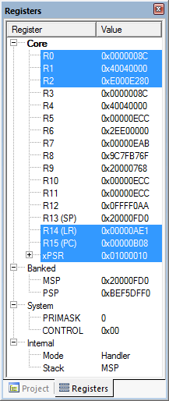
What Will Be Popped from Stack?
R4: 0x4040_0000
PC: 0xFFFF_FFF9
Saved R4
Saved LR
Saved R0
Saved R1
Saved R2
Saved R3
Saved R12
Saved LR
Saved PC
Saved xPSR

Slide 29
2. Select Stack, Restore Context
Check EXC_RETURN (bit 2) to determine from which SP to pop the context
Pop the registers from that stack
EXC_RETURN | Return Stack | Description
0xFFFF_FFF1 | 0 (MSP) | Return to exception handler with MSP
0xFFFF_FFF9 | 0 (MSP) | Return to thread with MSP
0xFFFF_FFFD | 1 (PSP) | Return to thread with PSP
 |  | <previous> | SP points here after handler
 | SP + 0x1C | xPSR
 | SP + 0x18 | PC
Decreasing | SP + 0x14 | LR
memory | SP + 0x10 | R12
address | SP + 0x0C | R3
 | SP + 0x08 | R2
 | SP + 0x04 | R1
 | SP + 0x00 | R0 | SP points here during handler

Slide 30
Example
PC=0xFFFF_FFF9, so return to thread mode with main stack pointer
Pop exception stack frame from stack back into registers
Saved R0
Saved R1
Saved R2
Saved R3
Saved R12
Saved LR
Saved PC
Saved xPSR

Slide 31
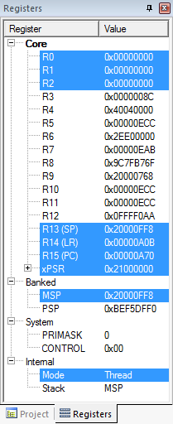
Resume Executing Previous Main Thread Code
Exception handling registers have been restored: R0, R1, R2, R3, R12, LR, PC, xPSR
SP is back to previous value
Back in thread mode
Next instruction to execute is at 0x0000_0A70

Slide 32
Processor Core Interrupts

Slide 33
Microcontroller Interrupts
Types of interrupts
Hardware interrupts
Asynchronous: not related to what code the processor is currently executing
Examples: interrupt is asserted, character is received on serial port, or ADC converter finishes conversion
Exceptions, Faults, software interrupts
Synchronous: are the result of specific instructions executing
Examples: undefined instructions, overflow occurs for a given instruction
We can enable and disable (mask) most interrupts as needed (maskable), others are non-maskable
Interrupt service routine (ISR)
Subroutine which processor is forced to execute to respond to a specific event
After ISR completes, MCU goes back to previously executing code

Slide 34
Nested Vectored Interrupt Controller
Port Module
ARM Cortex Core
Next Module
NVIC
Another Module
NVIC manages and prioritizes external interrupts
Interrupts are types of exceptions
Exceptions 16 through 16+N
Modes
Thread Mode: entered on Reset
Handler Mode: entered on executing an exception
Privilege level
Stack pointers
Main Stack Pointer, MSP
Process Stack Pointer, PSP
Exception states: Inactive, Pending, Active, A&P

Slide 35
NVIC Registers and State
Enable - Allows interrupt to be recognized
Accessed through two registers (set bits for interrupts)
Set enable with NVIC_ISER, clear enable with NVIC_ICER
CMSIS Interface: NVIC_EnableIRQ(IRQnum), NVIC_DisableIRQ(IRQnum)
Pending - Interrupt has been requested but is not yet serviced
CMSIS: NVIC_SetPendingIRQ(IRQnum), NVIC_ClearPendingIRQ(IRQnum)

Slide 36
Core Exception Mask Register
Similar to “Global interrupt disable” bit in other MCUs
PRIMASK - Exception mask register (CPU core)
Bit 0: PM Flag
Set to 1 to prevent activation of all exceptions with configurable priority
Clear to 0 to allow activation of all exception
Access using CPS, MSR and MRS instructions
Use to prevent data race conditions with code needing atomicity
CMSIS-CORE API
void __enable_irq() - clears PM flag
void __disable_irq() - sets PM flag
uint32_t __get_PRIMASK() - returns value of PRIMASK
void __set_PRIMASK(uint32_t x) - sets PRIMASK to x

Slide 37
Prioritization
Exceptions are prioritized to order the response simultaneous requests (smaller number = higher priority)
Priorities of some exceptions are fixed
Reset: -3, highest priority
NMI: -2
Hard Fault: -1
Priorities of other (peripheral) exceptions are adjustable
Value is stored in the interrupt priority register (IPR0-7)
0x00
0x40
0x80
0xC0

Slide 38
Special Cases of Prioritization
Simultaneous exception requests?
Lowest exception type number is serviced first
New exception requested while a handler is executing?
New priority higher than current priority?
New exception handler preempts current exception handler
New priority lower than or equal to current priority?
New exception held in pending state
Current handler continues and completes execution
Previous priority level restored
New exception handled if priority level allows

Slide 39
Timing Analysis

Slide 40
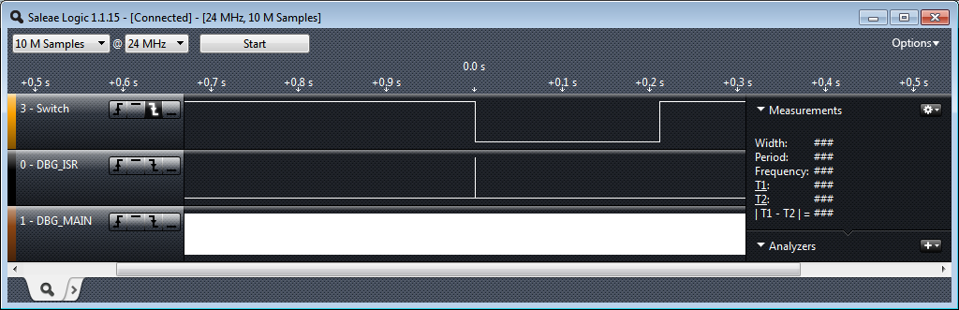
Big Picture Timing Behavior
Switch was pressed for about 0.21 s
ISR runs in response to switch signal’s falling edge
Main seems to be running continuously (signal toggles between 1 and 0)
Does it really? You will investigate this in the lab exercise.

Slide 41
Interrupt Response Latency
Latency = time delay
Why do we care?
This is overhead which wastes time, and increases as the interrupt rate rises
This delays our response to external events, which may or may not be acceptable for the application, such as sampling an analog waveform
How long does it take?
Finish executing the current instruction or abandon it
Push various registers on to the stack, fetch vector
C_{IntResponseOvhd}: Overhead for responding to each interrupt
If we have external memory with wait states, this takes longer

Slide 42
Maximum Interrupt Rate
We can only handle so many interrupts per second
F_{Max_Int}: maximum interrupt frequency
F_{CPU}: CPU clock frequency
C_{ISR}: Number of cycles ISR takes to execute
C_{Overhead}: Number of cycles of overhead for saving state, vectoring, restoring state, etc.
F_{Max_Int} = F_{CPU}/(C_{ISR}+ C_{Overhead})
Note that model applies only when there is one interrupt in the system
When processor is responding to interrupts, it isn’t executing our other code
U_{Int}: Utilization (fraction of processor time) consumed by interrupt processing
U_{Int} = 100%*F_{Int}* (C_{ISR}+C_{Overhead})/ F_{CPU}
CPU looks like it’s running the other code with CPU clock speed of (1-U_{Int})*F_{CPU}

Slide 43
Program Design with INterrupts

Slide 44
Program Design with Interrupts
How much work to do in ISR?
Should ISRs re-enable interrupts?
How to communicate between ISR and other threads?
Data buffering
Data integrity and race conditions

Slide 45
How Much Work Is Done in ISR?
Trade-off: Faster response for ISR code will delay completion of other code
In system with multiple ISRs with short deadlines, perform critical work in ISR and buffer partial results for later processing

Slide 46
Sharing Data Safely between ISRs and other Threads

Slide 47
Overview
Volatile data – can be updated outside of the program’s immediate control
Non-atomic shared data – can be interrupted partway through read or write, is vulnerable to race conditions

Slide 48
Volatile Data
Compilers assume that variables in memory do not change spontaneously, and optimize based on that belief
Don’t reload a variable from memory if current function hasn’t changed it
Read variable from memory into register (faster access)
Write back to memory at end of the procedure, or before a procedure call, or when compiler runs out of free registers
This optimization can fail
Example: reading from input port, polling for key press
while (SW_0) ; will read from SW_0 once and reuse that value
Will generate an infinite loop triggered by SW_0 being true
Variables for which it fails
Memory-mapped peripheral register – register changes on its own
Global variables modified by an ISR – ISR changes the variable
Global variables in a multithreaded application – another thread or ISR changes the variable

Slide 49
The Volatile Directive
Need to tell compiler which variables may change outside of its control
Use volatile keyword to force compiler to reload these vars from memory for each use volatile unsigned int num_ints;
Pointer to a volatile int volatile int * var; // or int volatile * var;
Now each C source read of a variable (e.g. status register) will result in an assembly language LDR instruction
Good explanation in Nigel Jones’ “Volatile,” Embedded Systems Programming July 2001

Slide 50
Non-Atomic Shared Data
void GetDateTime(DateTimeType * DT){
DT->day = current_time.day;
DT->hour = current_time.hour;
DT->minute = current_time.minute;
DT->second = current_time.second;
}
Want to keep track of current time and date
Use 1 Hz interrupt from timer
System
current_time structure tracks time and days since some reference event
current_time’s fields are updated by periodic 1 Hz timer ISR
void DateTimeISR(void){
current_time.second++;
if (current_time.second > 59){
current_time.second = 0;
current_time.minute++;
if (current_time.minute > 59) {
current_time.minute = 0;
current_time.hour++;
if (current_time.hour > 23) {
current_time.hour = 0;
current_time.day++;
… etc.
}

Slide 51
Example: Checking the Time
Problem
An interrupt at the wrong time will lead to half-updated data in DT
Failure Case
current_time is {10, 23, 59, 59} (10th day, 23:59:59)
Task code calls GetDateTime(), which starts copying the current_time fields to DT: day = 10, hour = 23
A timer interrupt occurs, which updates current_time to {11, 0, 0, 0}
GetDateTime() resumes executing, copying the remaining current_time fields to DT: minute = 0, second = 0
DT now has a time stamp of {10, 23, 0, 0}.
The system thinks time just jumped backwards one hour!
Fundamental problem – “race condition”
Preemption enables ISR to interrupt other code and possibly overwrite data
Must ensure atomic (indivisible) access to the object
Native atomic object size depends on processor’s instruction set and word size.
Is 32 bits for ARM

Slide 52
Examining the Problem More Closely
Must protect any data object which both:
Requires multiple instructions to read or write (non-atomic access), and
Is potentially written by an ISR
How many tasks/ISRs can write to the data object?
One? Then we have one-way communication
Must ensure the data isn’t overwritten partway through being read
Writer and reader don’t interrupt each other
More than one?
Must ensure the data isn’t overwritten partway through being read
Writer and reader don’t interrupt each other
Must ensure the data isn’t overwritten partway through being written
Writers don’t interrupt each other

Slide 53
Definitions
Race condition: Anomalous behavior due to unexpected critical dependence on the relative timing of events. Result of example code depends on the relative timing of the read and write operations.
Critical section: A section of code which creates a possible race condition. The code section can only be executed by one process at a time. Some synchronization mechanism is required at the entry and exit of the critical section to ensure exclusive use.

Slide 54
Solution: Briefly Disable Preemption
Prevent preemption within critical section
If an ISR can write to the shared data object, need to disable interrupts
save current interrupt masking state in m
disable interrupts
Restore previous state afterwards (interrupts may have already been disabled for another reason)
Use CMSIS-CORE to save, control and restore interrupt masking state
Avoid if possible
Disabling interrupts delays response to all other processing requests
Make this time as short as possible (e.g. a few instructions)
void GetDateTime(DateTimeType * DT){
uint32_t m;
m = __get_PRIMASK();
__disable_irq();
DT->day = current_time.day;
DT->hour = current_time.hour;
DT->minute = current_time.minute;
DT->second = current_time.second;
__set_PRIMASK(m);
}

Slide 55
Useful Resources
Cortex-M4 Technical Reference Manual:
http://infocenter.arm.com/help/topic/com.arm.doc.ddi0439d/DDI0439D_cortex_m4_processor_r0p1_trm.pdf
Cortex-M4 Devices Generic User Guide:
http://infocenter.arm.com/help/topic/com.arm.doc.dui0553a/DUI0553A_cortex_m4_dgug.pdf
Nucleo F401RE Reference Manual:
http://www.st.com/web/en/resource/technical/document/reference_manual/DM00096844.pdf
“The Definitive Guide to ARM Cortex-M3 and Cortex-M4 Processors” by Joseph Yiu, ISBN 13: 9780124080829 ISBN 10: 0124080820, 13 December 2013

